Slide 1
CS 402: DATA MINING AND WAREHOUSING

Slide 2
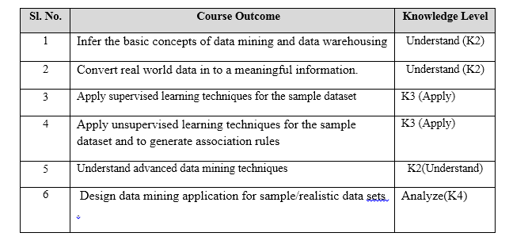
Expected Outcome:

Slide 3
Module 1
Data Mining:- Concepts and Applications, Data Mining Stages, Data Mining Models, Data Warehousing (DWH) and On-Line Analytical Processing (OLAP), Need for Data Warehousing, Challenges, Application of Data Mining Principles, OLTP Vs DWH, Applications of DWH

Slide 4
Module 2
Data Preprocessing: Data Preprocessing Concepts, Data Cleaning, Data integration and transformation, Data Reduction, Discretization and concept hierarchy.

Slide 5
Module 3
Classification Models: Introduction to Classification and Prediction, Issues regarding classification and prediction, Decision Tree- ID3, C4.5, Naive Bayes Classifier.

Slide 6
Module 4
Rule based classification- 1R. Neural Networks-Back propagation. Support Vector Machines, Lazy Learners-K Nearest Neighbor Classifier. Accuracy and error Measures evaluation. Prediction:-Linear Regression and Non-Linear Regression.

Slide 7
Module 5
Association Rules Mining: Concepts, Apriori and FP-Growth Algorithm. Cluster Analysis: Introduction, Concepts, Types of ,data in cluster analysis Categorization of clustering methods. Partitioning method: K-Means and K-Medoid Clustering.

Slide 8
Module 6
Hierarchical Clustering method: BIRCH. Density-Based Clustering –DBSCAN and OPTICS.
Advanced Data Mining Techniques: Introduction, Web Mining- Web Content Mining, Web Structure Mining, Web Usage Mining. Text Mining.
Graph mining:- Apriori based approach for mining frequent subgraphs.
Social Network Analysis:- characteristics of social networks. Link mining:- Tasks and challenges.

Slide 9
Text Books:
Dunham M H, “Data Mining: Introductory and Advanced Topics”, Pearson Education, New Delhi, 2003.
Jaiwei Han and Micheline Kamber, “Data Mining Concepts and Techniques”, Elsevier, 2006.

Slide 10
Data is “raw, unanalyzed, unorganized, unrelated, uninterrupted material which is used to derive information after analyzation.”
Information is the set of data that has already been processed, analyzed, and structured in a meaningful way to become useful.

Slide 11
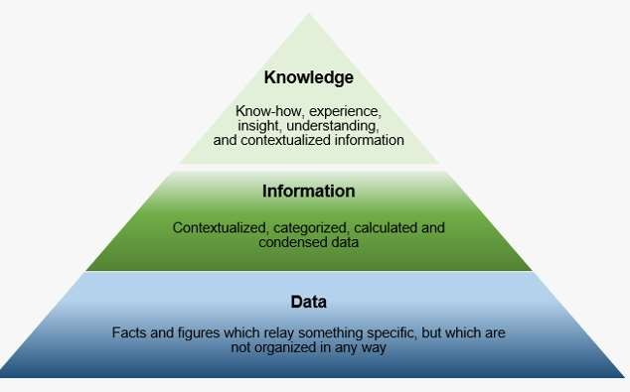

Slide 12
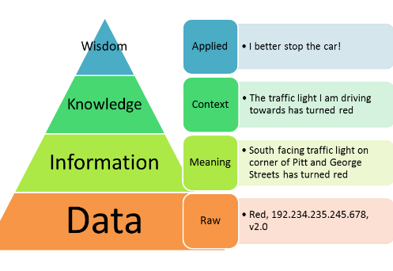

Slide 13
Knowledge Discovery in Databases (KDD)
Knowledge Discovery in Databases (KDD) is the non-trivial extraction of implicit, previously unknown and potentially useful knowledge from data.
Process of converting data to knowledge

Slide 14
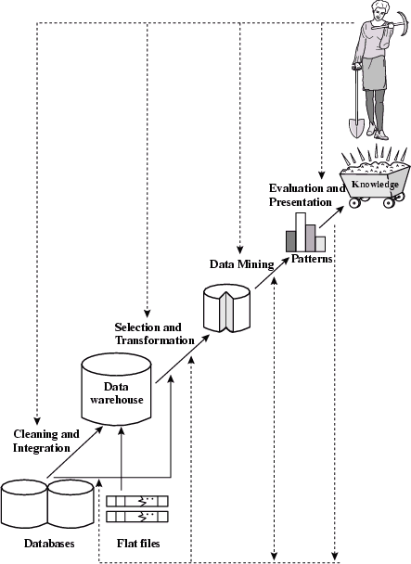
Data mining: the core of knowledge discovery process

Slide 15
Data mining
It is the process of discovering interesting and useful patterns and relationships in large volumes of data stored in data bases ,dataware houses or other information repositories

Slide 16
Data mining
Data mining is the exploration and analysis of large quantities of data in order to discover valid, novel, potentially useful, and ultimately understandable patterns in data.
Process of analyzing large databases to find patterns that are:
–
Valid: The patterns hold in general.
Novel: We did not know the pattern beforehand.
Useful: We can devise actions from the patterns.
Understandable: : humans should be able to interpret the pattern

Slide 17
Why Data Mining?
The Explosive Growth of Data: from terabytes to petabytes
Data collection and data availability
Automated data collection tools, database systems, Web, computerized society
Major sources of abundant data
Business: Web, e-commerce, transactions, stocks, …
Science: Remote sensing, bioinformatics, scientific simulation, …
Society and everyone: news, digital cameras,
We are drowning in data, but starving for knowledge!
“Necessity is the mother of invention”—Data mining—Automated analysis of massive data sets
9

Slide 18
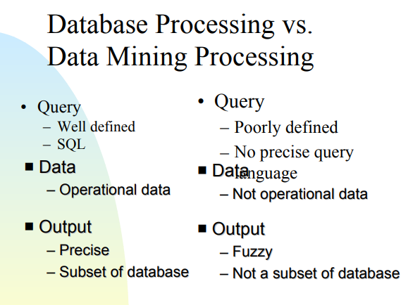

Slide 19
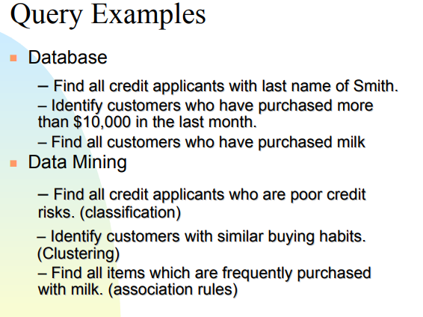

Slide 20
Applications
Banking: loan/credit card approval
predict good customers based on old customers
Customer relationship management:
Predict which customers are likely to leave your company and go to a competitor..
Targeted marketing:
Which customers will buy computer
Fraud detection: telecommunications, financial transactions
from an online stream of event identify fraudulent events

Slide 21
Data mining: the core of knowledge discovery process

Slide 22
DM and knowlegde discovery in database(KDD)
Data cleaning (to remove noise and inconsistent data)
Data integration (where multiple data sources may be combined)
Data selection (where data relevant to the analysis task are retrieved from the database)
Data transformation (where data are transformed and consolidated into forms
appropriate for mining by performing summary or aggregation operations)

Slide 23
DM and knowlegde discovery in database(KDD)
Data mining (an essential process where intelligent methods are applied to extract data patterns)
Pattern evaluation (to identify the truly interesting patterns representing knowledge based on interestingness measures)
Knowledge presentation (where visualization and knowledge representation techniqueare used to present mined knowledge to users)

Slide 24
Stages of “Data mining”
Exploration:
Model building and validation: 3.Deployment:

Slide 25
Stages of “Data mining”
Exploration:
This stage involves preparation and collection of data.
Also involves data cleaning, transformation.
Based on size of data, different tools to analyze the data may be required.

Slide 26
stages of “Data mining”
Model building and validation:
This stage involves choosing the best model based on their predictive performance.
The model is then applied on the different data sets and compared for best performance.
This stage is also called as pattern identification.

Slide 27
stages of “Data mining”
Deployment:
Based on model selected in previous stage, it is applied to the data sets.
This is to generate predictions or estimates of the expected outcome.

Slide 28
Data Mining Functionalities/Techniques::
Specifies What Kinds of Patterns Can Be Mined using different data mining techniques

Slide 29
Functionalities/Techniques:
Concept/Class Description: Characterization and Discrimination
Mining Frequent Patterns, Associations and correlations
Classification and Prediction
Cluster Analysis
Outlier Analysis
Evolution Analysis

Slide 30
Concept/Class Description: Characterization and Discrimination
Data entries can be associated with classes or concepts.
For example, in the AllElectronics store, classes of items for sale include computers and printers, and concepts of customers include bigSpenders and budgetSpenders.
It can be useful to describe individual classes
and concepts in summarized, concise, and yet precise terms.
Such descriptions of a class or a concept are called class/concept descriptions

Slide 31
Concept/Class Description: Characterization and Discrimination
Concept/Class Description are derived via
Data Characterization
Data Discrimination
Both data characterization and discrimination

Slide 32
Concept/Class Description: Characterization and Discrimination
Data Characterization: A data mining system should be able to produce a description summarizing the characteristics of customers.
Example: The characteristics of customers who spend more than
$1000 a year at (some store called ) AllElectronics.
The result can be a general profile such as age, employment status or credit ratings.

Slide 33
Concept/Class Description: Characterization and Discrimination
Data Characterization: A data mining system should be able to produce a description summarizing the characteristics of customers.
Example: The characteristics of customers who spend more than
$1000 a year at (some store called ) AllElectronics.
The result can be a general profile such as age, employment status or credit ratings.

Slide 34
Data Discrimination
Data Discrimination: It is a comparison of the general features of targeting class data objects with the general features of objects from one or a set of contrasting classes.
User can specify target and contrasting classes.
summarizing the data of the class under study (often called the target class)
Example: compare customers who shop for computer products regularly with those who rarely shop for such products
The resulting description provides a general comparative profile of these customers

Slide 35
Mining Frequent Patterns, Associations and correlations
Frequent Patterns : as the name suggests patterns that occur frequently in data.
It includes
itemset
subsequences
sub structures

Slide 36
Mining Frequent Patterns, Associations and correlations
A frequent itemset typically refers to a set of items that frequently appear together in a transactional data set, such as milk and bread.
A frequently occurring subsequence,such as the pattern that customers tend to purchase first a PC, followed by a digital camera, and then a memory card, is a (frequent) sequential pattern.
A substructure can refer to different structural forms, such as graphs, trees, or lattices, which may be combined with item sets or subsequences.
Mining frequent patterns leads to the discovery of interesting associations and correlations within data.

Slide 37
Eg of association rule
buys(X; “computer”)⇒buys(X; “software”) [support = 1%; confidence = 50%]
Where X is a variable representing a customer
A confidence, or certainty, of 50% means that if a customer buys a computer, there is a 50% chance that she will buy software as well.
A 1% support means that 1% of all of the transactions under analysis showed that computer and software were purchased together
Association rules are discarded as uninteresting if they do not satisfy both a minimum support threshold and a minimum confidence threshold
Correlations are used to solve this problem

Slide 38
Classification and Prediction
Classification is the process of finding a model that describes and distinguishes data classes or concepts .
The model are derived based on the analysis of a set of training data
The model can be used to predict the class of objects whose class label is unknown.
Classification model can be represented in various forms such as
» IF-THEN Rules
» A decision tree
» Neural network

Slide 39
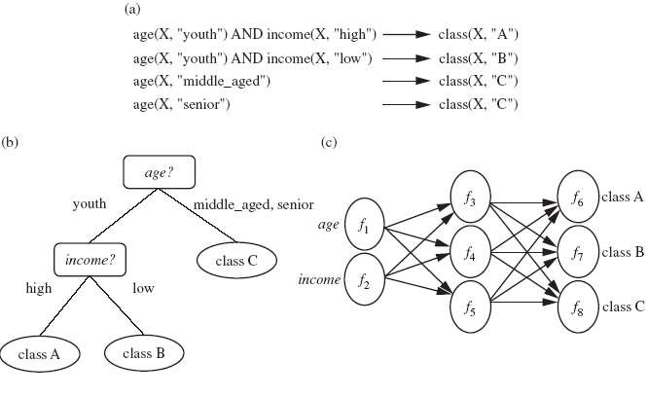
Classification Model

Slide 40
Prediction
classification predicts categorical (discrete, unordered) labels,
Prediction models continuous-valued functions.
It is used to predict missing or unavailable numerical data values rather than class labels.

Slide 41
Cluster Analysis
Clustering
Grouping data into different groups so that data in each group share similar trends and patterns
Example:
Marketing :finding group of customers with similar buying habit

Slide 42
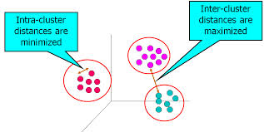
Cluster Analysis
Clustering is used if the class label is unknown
The objects are clustered or grouped based on the principle of maximizing the intraclass similarity and minimizing the interclass similarity.

Slide 43
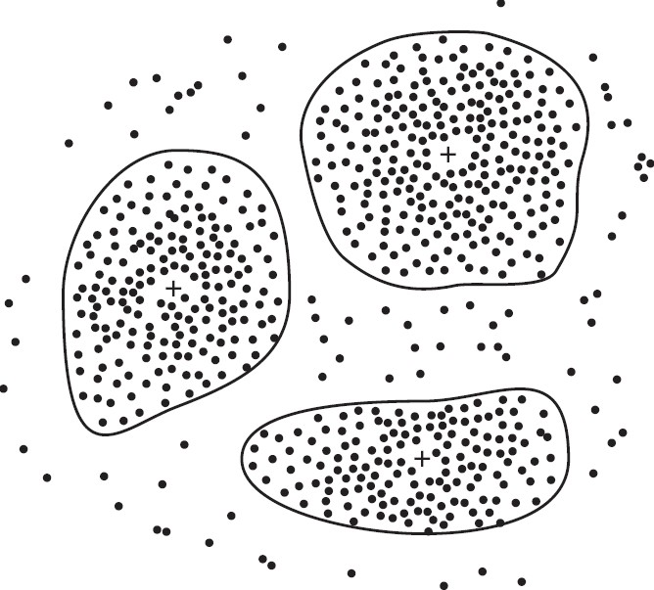
Cluster Analysis

Slide 44
Outlier Analysis
A data set which differ significantly from the remaining data objects are refered to as outliers.
Many data mining methods discard outliers as noise or exceptions
Example: Use in finding Fraudulent usage of credit cards.
Outlier Analysis may uncover Fraudulent usage of credit cards by detecting purchases of extremely large amounts for a given account number in comparison to regular charges incurred by the same account.
Outlier values may also be detected with respect to the location and type of purchase or the purchase frequency.

Slide 45
Evolution Analysis
Evolution Analysis: Data evolution analysis describes and models regularities or trends for objects whose behavior changes over time.
Example: stock market data

Slide 46
Classification or Clustering Task
Analysis the customer data to predict whether he will by computer accessories (Target
class: Yes or No)
grouping similar language type documents (Same language documents are one group.)
Gender classification from hair length (Target classes: Male or Female)
Classifying fruits from each fruit feature like colour, taste, size, weight (Targe class: Apple,
Orange, Cherry, Banana)
•
While categorising the news articles (Same news category(Sport) articles are one group

Slide 47
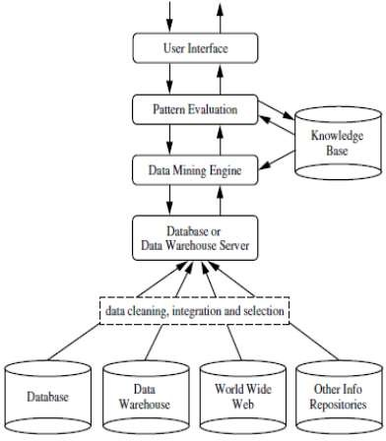
Architecture of Data Mining System

Slide 48
Knowledge Base:
This is the domain knowledge that is used to guide the search or evaluate the interestingness of resulting patterns.
Knowledge such as user beliefs, which can be used to assess a pattern’s interestingness based on its unexpectedness, may also be included.
Other examples of domain knowledge are additional interestingness constraints or thresholds, and metadata (e.g., describing data from multiple heterogeneous sources).

Slide 49
Data Mining Engine:
This is essential to the data mining system and ideally consists of a set of functional modules for tasks such as
characterization,
association and correlation analysis, classification,
prediction,
cluster analysis,
outlier analysis,
evolutionanalysis.

Slide 50
Pattern Evaluation Module:
This component typically employs interestingness measures interacts with the data mining modules so as to focus the search toward interesting patterns.
It may use interestingness thresholds to filter out discovered patterns.

Slide 51
User interface:
This module communicates between users and the data mining system
Allows the user to interact with the system by specifying a data mining query or task, providing information to help focus the search, and performing exploratory datamining based on the intermediate data mining results

Slide 52
Popular data mining tools
Rapid Miner
Orange
Weka
KNIME
Oracle Data Mining
Rattle
DataMelt

Slide 53
DATA WAREHOUSING

Slide 54
Data warehouse
A data warehouse is a collection of integrated databases designed to support a Decision Support System.
It is the consolidation of data from several databases which are in turn maintained by individual business units along with historical and summary information
A data warehouse is the data repository of an enterprise.
It is generally used for research and decision support
A data warehouse is based on a multidimensional data model which views data in the form of a data cube

Slide 55
Data Warehousing
A process of transforming data into information and making it available to users

Slide 56
Definition of data warehouse
“A data warehouse is a subject-oriented, integrated, time-variant, and nonvolatile collection of data in support of management’s decision making process” .
The four keywords, subject-oriented, integrated, time-variant, and nonvolatile, distinguish data warehouses from other data repository systems, such as relational database systems, transaction processing systems, and file systems

Slide 57
Subject-oriented:
Data is organized and summarized by topic
ie A data warehouse is organized around major subjects, such as cus-tomer, supplier, product, and sales.
data warehouses typically provide a simple and concise view around particular subject issues by excluding data that are not useful in the decision support process.

Slide 58
Integrated:
A data warehouse is usually constructed by integrating multiple heterogeneous sources, such as relational databases, flat files, and on-line transaction records.
Data cleaning and data integration techniques are applied to ensure consistency in naming conventions, encoding structures, attribute measures, and so on.

Slide 59
Time-variant:
Data warehouses are time variant in the sense that they maintain both historical and (nearly) current data
Data are stored to provide information from a historical perspective (e.g., the past 5–10 years).

Slide 60
Nonvolatile:
Data are stored in read-only format and do not change over time
Once data is entered it is NEVER removed
Represents the company’s entire history
Near term history is continually added to it
Always growing

Slide 61
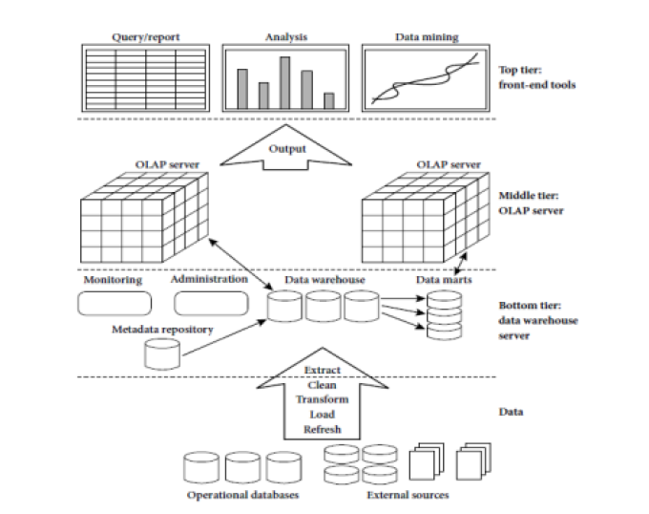
Three Tier Data Warehouse Architecture

Slide 62
Tier-1:
The bottom tier is a warehouse database server that is almost always a relational database system.
Back-end tools and utilities are used to feed data into the bottom tier from operational databases or other external sources (such as customer profile information provided by external consultants).
These tools and utilities perform data extraction, cleaning, and transformation (e.g., to merge similar data from different sources into a unified format), as well as load and refresh functions to update the data warehouse .

Slide 63
Tier-1:
The data are extracted using application program interfaces known as gateways. A gateway is supported by the underlying DBMS and allows client programs to generate SQL code to be executed at a server.
Examples of gateways include ODBC (Open Database Connection) and OLEDB (Open Linking and Embedding for Databases) by Microsoft and JDBC (Java Database Connection).
This tier also contains a metadata repository, which stores information about the data warehouse and its contents.

Slide 64
Meta data
Metadata is “data about data”.
Metadata are abstractions -- they are high level data that provide concise descriptions of lower-level data
For example, a line in a sales database may contain: 4056 KJ596 223.45
This is mostly meaningless until we consult the metadata that tells us it was store number 4056, product KJ596 and sales of
$223.45

Slide 65
The metadata are essential ingredients in the transformation of raw data into knowledge.
They are the “keys” that allow us to handle the raw data.
It acts as the glue that connects all parts of the data warehouse.
It provides information about the contents and structures to the developers.
It opens the door to the end-users and makes the contents recognizable in their own terms.

Slide 66
Meta data Uses
It is used for variety of purposed including:
The extraction and loading process
The warehouse management process
Query Management process

Slide 67
Meta data Uses
It is used for variety of purposed including:
The extraction and loading process – Meta data is used to map data sources to a common view of information within the warehouse.
The warehouse management process – Meta data is used to automate the production of summary tables.
As part of Query Management process Meta data is used to direct a query to the most appropriate data source.

Slide 68
Data Marts
A data mart is a simple form of a data warehouse that is focused on a single subject (or functional area), such as Sales, Finance, or Marketing.
More manageable data sets
Targeted to meet the needs of small groups within the organization
Small, Single-Subject data warehouse subset that provides decision support to a small group of people

Slide 69
Data Marts
Data marts are often built and controlled by a single department within an organization
The difference between a data warehouse and a data mart can be confusing because the two terms are sometimes used incorrectly as synonyms.
A data warehouse is a central repository for all an organization's data.
The goal of a data mart, however, is to meet the particular demands of a specific group of users within the organization, such as human resource management (HRM).
A data mart is a scaled down version of a data warehouse that focuses on a particular subject area

Slide 70
Data warehouse Administration and Management
Managing data warehouse includes
Security and priority management
Monitoring updates from multiple sources
Data quality checks
Managing and updating meta data
Auditing and reporting data warehouse usage and status.
Purging data
Replicating sub setting and distributing data
Back up and recovery
Data warehouse storage management

Slide 71
Tier-2:
The middle tier is an OLAP server that is typically implemented using either a relational OLAP (ROLAP) model or a multidimensional OLAP.
OLAP model is an extended relational DBMS that maps operations on multidimensional data to standard relational operations .
A multidimensional OLAP (MOLAP) model, that is, a special-purpose server that directly implements multidimensional data and operations.

Slide 72
Tier-3:
The top tier is a front-end client layer, which contains query and reporting tools, analysis tools, and/or data mining tools (e.g., trend analysis, prediction, and so on)

Slide 73
On-Line Analytical Processing (OLAP):
Technology used to perform complex analysis of the data in a data warehouse
OLAP queries are complex queries that
Touch large amounts of data
Discover patterns and trends in the data
Typically expensive queries that take long time
Also called decision-support queries

Slide 74
OLAP (online analytical processing)
OLAP (online analytical processing) is computer processing that enables a user to easily and selectively extract and view data from different points of view.
OLAP allows users to analyze database information from multiple database systems at one time.
OLAP data is stored in multidimensional databases.

Slide 75
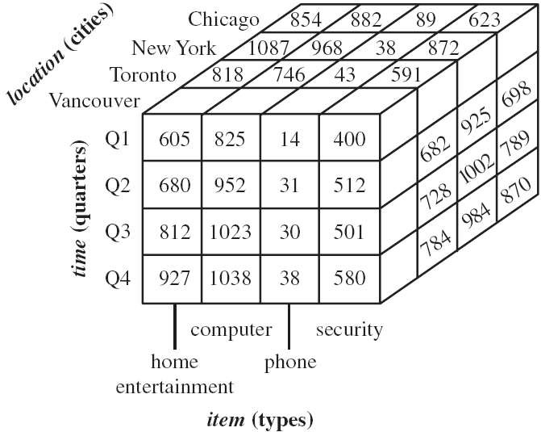
3D Data cube Example
A data cube, such as sales, allows data to be modeled and viewed in multiple dimensions
Suppose ALLELETRONICS create a sales data warehouse with respect to dimensions
Time
Item
Location

Slide 76
OLTP: Online Transaction Processing
In contrast to OLAP:
OLTP: Online Transaction Processing •
OLTP queries are simple queries, e.g., over banking or airline systems
OLTP queries touch small amount of data for fast transactions

Slide 77
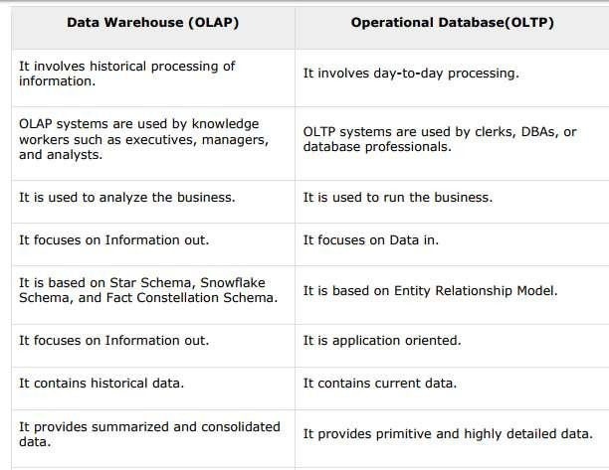
Difference between OLAP and OLTP

Slide 78
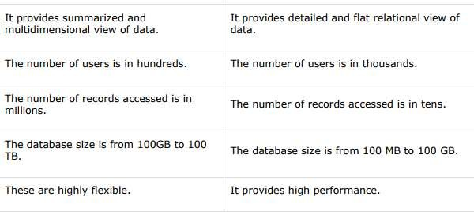

Slide 79
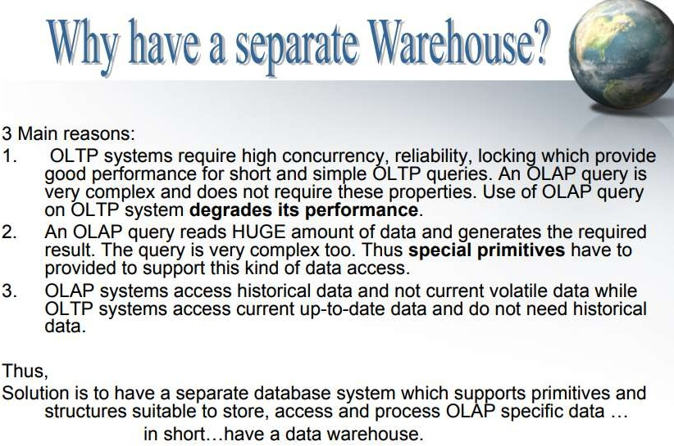

Slide 80
Concept Hierarchy
A Concept Hierarchy defines a sequence of mappings from a set of low-level concepts to high-level
Consider a concept hierarchy for the dimension “Location”

Slide 81
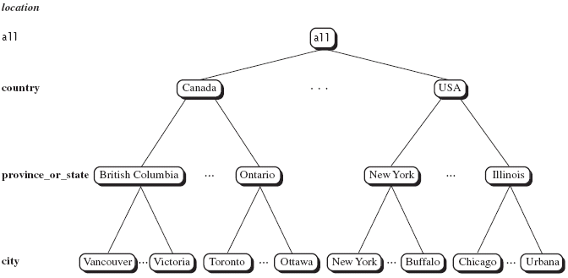
concept hierarchy for the dimension “Location”

Slide 82
Typical OLAP Operations
Roll-up
Drill-down
Slice and dice
Pivot (rotate)

Slide 83
Roll up (drill-up):summarize data
This operation performs aggregation on a data cube in any of the following way:
By climbing up a concept hierarchy for a dimension
By dimension reduction.

Slide 84
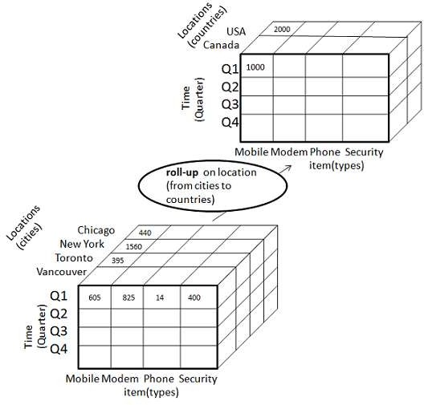

Slide 85
The roll-up operation is performed by climbing up a concept hierarchy for the dimension location.
Initially the concept hierarchy was "street < city < province < country".
On rolling up the data is aggregated by ascending the location hierarchy from the level of city to level of country
.
Then roll-up operation is performed then one or more dimensions from the data cube are removed.

Slide 86
Drill down (roll down):
reverse of roll-up
Drill-down operation is reverse of the roll-up.
This operation is performed by either of the following way:
By stepping down a concept hierarchy for a dimension.
By introducing new dimension.

Slide 87
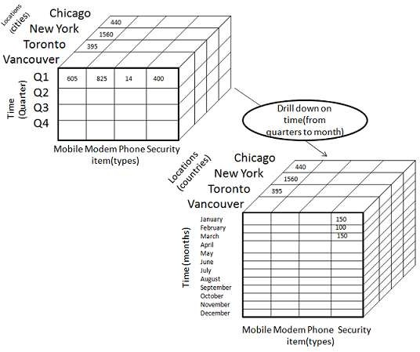

Slide 88
The drill-down operation is performed by stepping down a concept hierarchy for the dimension time.
Initially the concept hierarchy was "day < month < quarter < year.“
On drill-up the time dimension is descended from the level quarter to the level of month.
When drill-down operation is performed then one or more dimensions from the data cube are added.
It navigates the data from less detailed data to highly detailed data.

Slide 89
Slice(selection)
The slice operation performs selection of one dimension on a given cube and give us a new sub cube.

Slide 90
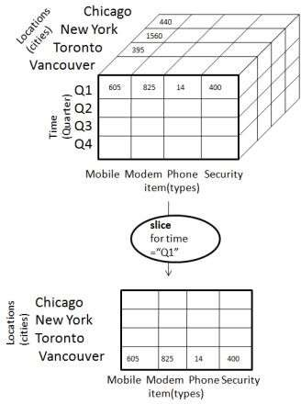
The Slice operation is performed for the dimension time using the criterion time ="Q1".
It will form a new sub cube by selecting one or more dimensions.

Slide 91
Dice
The Dice operation performs selection of two or more dimension on a given
cube and give us a new subcube.

Slide 92
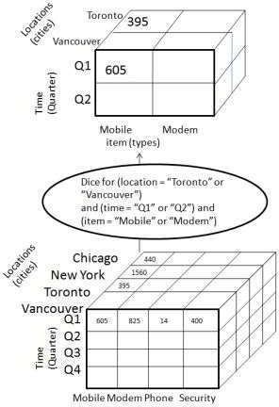
The dice operation on the cube based on the following selection criteria that involve three dimensions.
(location = "Toronto" or "Vancouver")
(time = "Q1" or "Q2")
(item =" Mobile" or "Modem").

Slide 93
Pivot(rotation)
Pivot
The pivot operation is also known as rotation.
It rotates the data axes in view in order to provide an alternative presentation of data

Slide 94
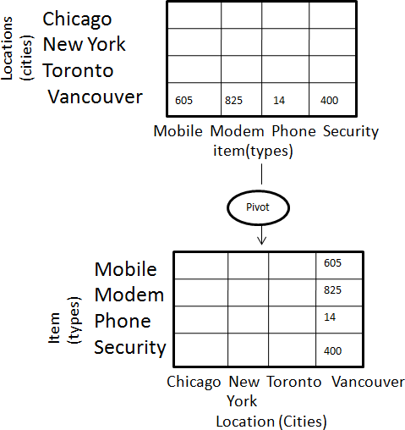
In this the item and location axes in 2-D slice are rotated

Slide 95
Data warehouse Schemas
Schema is a logical description of the entire database.
Like a database, a data warehouse also requires to maintain a schema.
A database uses relational model, while a data warehouse uses Star, Snowflake, and Fact Constellation schema.

Slide 96
Types of Data warehouse Schemas
Star Schema:
Snow Flake Schema:
Fact Constellation Schema:

Slide 97
Data warehouse Schemas
Fact table
It is a table that has values of the attributes of the dimension table
Dimension Table
A dimension table contains the dimensions along which the values of the attributes are taken in the fact table.

Slide 98
Conceptual Modeling of Data Warehouses/Data warehouse Schemas
Star schema: A fact table in the middle connected to a set of dimension tables
It contains:
A large central table (fact table)
A set of smaller attendant tables (dimension table), one for each dimension

Slide 99
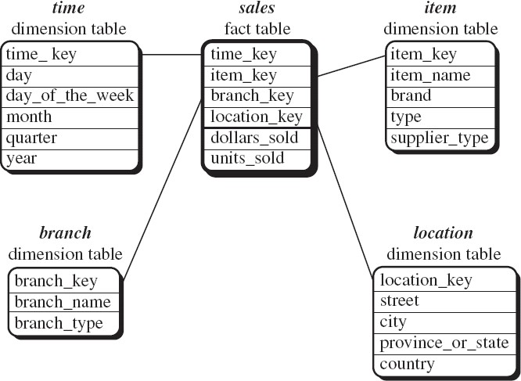
Star schema

Slide 100
Conceptual Modeling of Data Warehouses
Snowflake schema: A refinement of star schema where some dimensional hierarchy is further splitting (normalized) into a set of smaller dimension tables, forming a shape similar to snowflake
However, the snowflake structure can reduce the effectiveness of browsing, since more joins will be needed

Slide 101
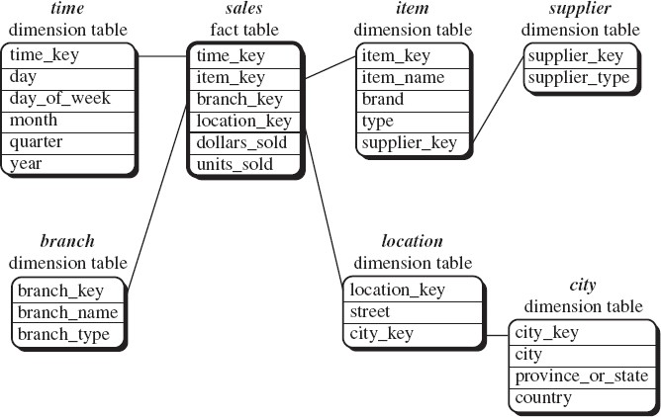
Snowflake schema

Slide 102
Conceptual Modeling of Data Warehouses
Fact constellations: Multiple fact tables share dimension tables
viewed as a collection of stars, therefore called galaxy schema or fact constellation

Slide 103
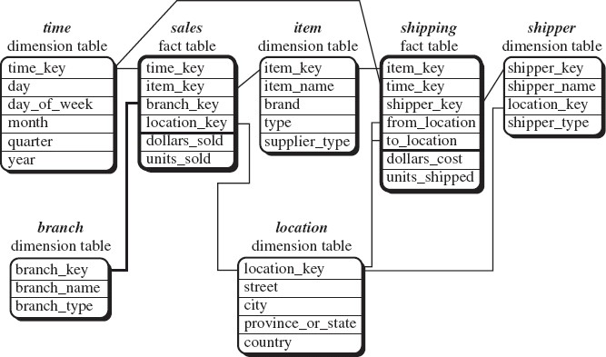
Fact constellations

Slide 104
Applications of datawarehouse

Slide 105
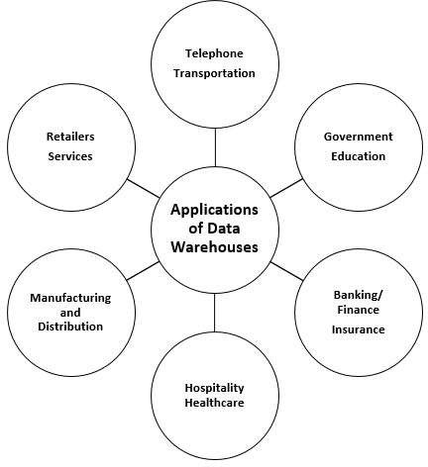

Slide 106
Banking Industry
Most banks use warehouses to manage the resources available on deck in an effective manner.
Certain banking sectors utilize them for market research, performance analysis of each product, interchange and exchange rates, and to develop marketing programs.
Analysis of card holder’s transactions, spending patterns and merchant classification, all of which provide the bank with an opportunity to introduce special offers and lucrative deals based on cardholder activity

Slide 107
Finance Industry
Similar to the applications seen in banking, mainly revolve around evaluation and trends of customer expenses which aids in maximizing the profits earned by their clients.

Slide 108
Consumer Goods Industry
They are used for prediction of consumer trends, inventory management, market and advertising research.
In-depth analysis of sales and production is also carried out.
Apart from these, information is exchanged business partners and clientele.

Slide 109
Government and Education
The federal government utilizes the warehouses for research in compliance, whereas the state government uses it for services related to human resources like recruitment, and accounting like payroll management.
The government uses data warehouses to maintain and analyze tax records, health policy records and their respective providers, and also their entire criminal law database is connected to the state’s data warehouse. Criminal activity is predicted from the patterns and trends, results of the analysis of historical data associated with past criminals.
Universities use warehouses for extracting of information used for the proposal of research grants, understanding their student demographics, and human resource management. The entire financial department of most universities depends on data warehouses, inclusive of the Financial Aid department.

Slide 110
Healthcare
& Hospitality Industry
Healthcare
All financial, clinical, and employee records are fed to warehouses as it helps them to strategize and predict outcomes, track and analyze their service feedback, generate patient reports, share data with tie-in insurance companies, medical aid services, etc.
Hospitality Industry
A major proportion of this industry is dominated by hotel and restaurant services, car rental services, and holiday home services.
They utilize warehouse services to design and evaluate their advertising and promotion campaigns where they target customers based on their feedback and travel patterns.

Slide 111
Insurance
The warehouses are primarily used to analyze data patterns and customer trends, apart from maintaining records of already existing participants. The design of tailor-made customer offers and promotions is also possible through warehouses.
Manufacturing and Distribution Industry
This industry is one of the most important sources of income for any state. A manufacturing organization has to take several make-or-buy decisions which can influence the future of the sector, which is why they utilize high-end OLAP tools as a part of data warehouses to predict market changes, analyze current business trends, detect warning conditions, view marketing developments, and ultimately take better decisions.
They also use them for product shipment records, records of product portfolios, identify profitable product lines, analyze previous data and customer feedback to evaluate the weaker product lines and eliminate them.

Slide 112
The Retailers
Retailers serve as middlemen between producers and consumers.
They use warehouses to track items, their advertising promotions, and the consumers buying trends.
They also analyze sales to determine fast selling and slow selling product lines and determine their shelf space through a process of elimination.
Services Sector
Data warehouses find themselves to be of use in the service sector for maintenance of financial records, revenue patterns, customer profiling, resource management, and human resources.

Slide 113
Telephone Industry
The telephone industry operates over both offline and online data burdening them with a lot of historical data which has to be consolidated and integrated.
Apart from those operations, analysis of fixed assets, analysis of customer’s calling patterns for sales representatives to push advertising campaigns, and tracking of customer queries, all require the facilities of a data warehouse.
Transportation Industry
In the transportation industry, data warehouses record customer data enabling traders to experiment with target marketing where the marketing campaigns are designed by keeping customer requirements in mind.
The internal environment of the industry uses them to analyze customer feedback, performance, manage crews on board as well as analyze customer financial reports for pricing strategies.

Slide 114
Challenges in DW
Data Quality
Understanding Analytics
Quality Assurance
Performance
Designing the Data Warehouse
User Acceptance
Cost

Slide 115
Challenges in DW
Data Quality – In a data warehouse, data is coming from many disparate sources from all facets of an organization.
When a data warehouse tries to combine inconsistent data from disparate sources, it encounters errors. Inconsistent data, duplicates, logic conflicts, and missing data all result in data quality challenges.
Poor data quality results in faulty reporting and analytics necessary for optimal decision making.
Understanding Analytics –. When building a data warehouse, analytics and reporting will have to be taken into design considerations.
In order to do this, the business user will need to know exactly what analysis will be perform

Slide 116
Quality Assurance – The end user of a data warehouse is using Big Data reporting and analytics to make the best decisions possible.
Consequently, the data must be 100 percent accurate or a credit union leader could make ill-advised decisions that are detrimental to the future success of their business.
This high reliance on data quality makes testing a high priority issue that will require a lot of resources to ensure the information provided is accurate.
The credit union will have to develop all of the steps required to complete a successful Software Testing Life Cycle (STLC), which will be a costly and time intensive process.

Slide 117
Performance – Building a data warehouse is similar to building a car.
A car must be carefully designed from the beginning to meet the purposes for which it is intended. Yet, there are options each buyer must consider to make the vehicle truly meet individual performance needs.
A data warehouse must also be carefully designed to meet overall performance requirements.
While the final product can be customized to fit the performance needs of the organization, the initial overall design must be carefully thought out to provide a stable foundation from which to start.

Slide 118
Designing the Data Warehouse – People generally don’t want to “waste” their time defining the requirements necessary for proper data warehouse design.
Usually, there is a high level perception of what they want out of a data warehouse.
However, they don’t fully understand all the implications of these perceptions and, therefore, have a difficult time adequately defining them.
This results in miscommunication between the business users and the technicians building the data warehouse.
The typical end result is a data warehouse which does not deliver the results expected by the user.
Since the data warehouse is inadequate for the end user, there is a need for fixes and improvements immediately after initial delivery.
The unfortunate outcome is greatly increased development fees.

Slide 119
User Acceptance – People are not keen to changing their daily routine especially if the new process is not intuitive.
There are many challenges to overcome to make a data warehouse that is quickly adopted by an organization.
Having a comprehensive user training program can ease this hesitation but will require planning and additional resources.

Slide 120
Cost – A frequent misconception among credit unions is that they can build data warehouse in-house to save money.
As the foregoing points emphasize, there are a multitude of hidden problems in building data warehouses.
Even if a credit union adds a data warehouse “expert” to their staff, the depth and breadth of skills needed to deliver an effective result is simply not feasible with one or a few experienced professionals leading a team of non-BI trained technicians.
The harsh reality is an effective do-it-yourself effort is very costly.

Slide 121
Assignment questions
Suppose that a data warehouse consists of the three dimensions time, doctor, and patient, and the two measures count and charge, where charge is the fee that a doctor charges a patient for a visit.
Draw a schema diagram for the above data warehouse using one of the schemas. [star, snowflake, fact constellation]

Slide 122
